Slide 1
Lightning Talk - 4/24
Python for Machine Learning - Dana Braatz

Slide 2
Some Python Tools Used for Machine Learning
Pandas
Offers data structures and operations for manipulating numeric tables + time series
Data manipulation and analysis
NumPy
Fast precompiled functions for numerical routines
Support for large, multi-dimensional arrays and matrices
Supplies a large library of high-level mathematical functions to operate on arrays
matplotlib
matplotlib is a plotting library for NumPy
Provides an API for embedding plots into applications using general-purpose GUI toolkits

Slide 3
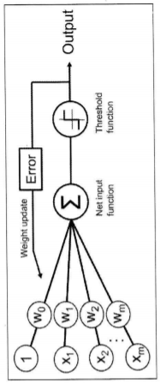
It Looks SOOOO Simple...
Code, illustrations, and graphics derived from: Python Machine Learning -
2nd. Ed. -- Sebastian Raschka
df.tail:
0 1 2 3 4
145 6.7 3.0 5.2 2.3 Iris-virginica
146 6.3 2.5 5.0 1.9 Iris-virginica
147 6.5 3.0 5.2 2.0 Iris-virginica
148 6.2 3.4 5.4 2.3 Iris-virginica
149 5.9 3.0 5.1 1.8 Iris-virginica
(dataframe)df = pandas.read_csv('https://ar…’)
# extract sepal length and petal length
X = df.iloc[0:100, [0, 2]].values

Slide 4
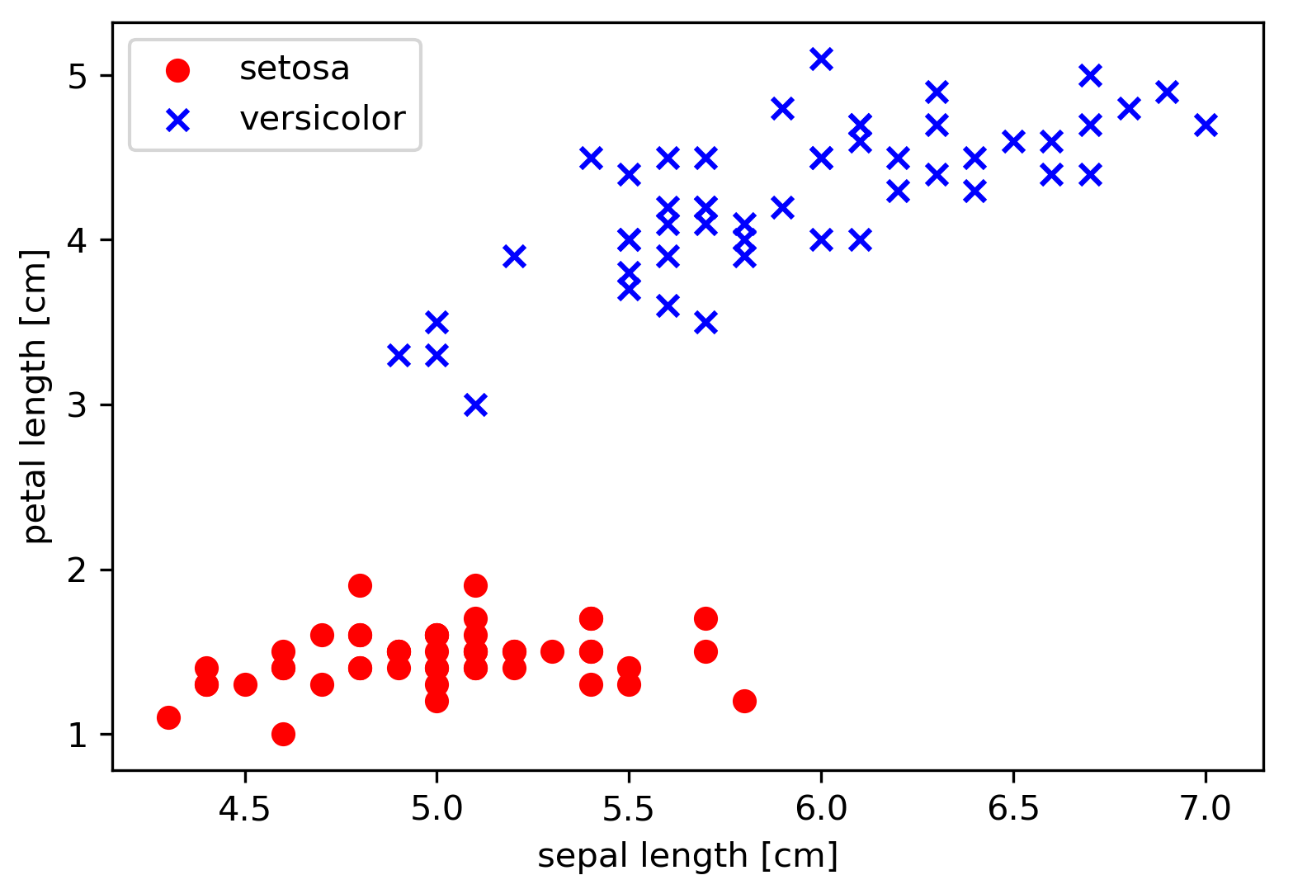
Scatter Plots to Test Our Two Features

Slide 5
Code Using matplotlib
import matplotlib.pyplot as plt
plt.scatter(X[:50, 0], X[:50, 1],
color='red', marker='o', label='setosa')
plt.scatter(X[50:100, 0], X[50:100, 1],
color='blue', marker='x', label='versicolor')

Slide 6
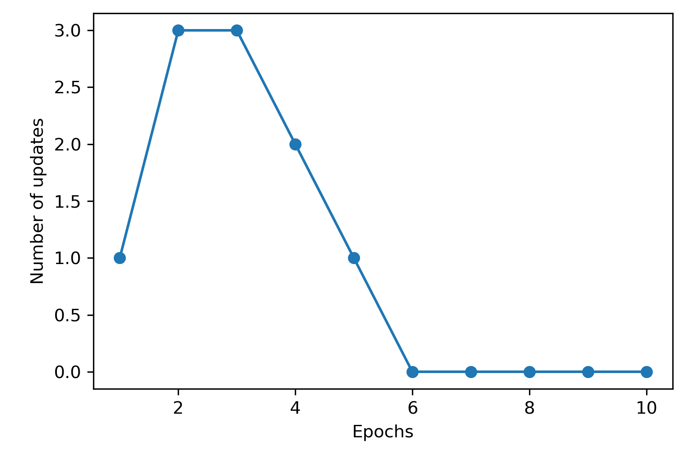
Using a Perceptron Learning Algorithm
# of updates = # of misclassified rows of data in the dataset during each pass.
Epochs = # of times the data- set has been tested.
(I set a max. = 10.)

Slide 7
Numpy Methods Help Feed the Algorithm
# select setosa and versicolor
y = np.where(y == 'Iris-setosa', -1, 1)
rgen = np.random.RandomState (self.random_state)
def net_input(self, X):
"""Calculate net input"""
return np.dot(X, self.w_[1:]) + self.w_[0]
np.random.RandomState
RandomState exposes a number of methods for generating random numbers drawn from a variety of probability distributions.
Np.dot:
dot(a, b, out=None)
Dot product of two arrays.

Slide 8

The Vastness and Flow of Machine Learning

Slide 9
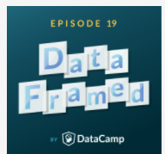
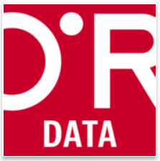
What Are You Listening To?
DataFramed
DataCamp’s official podcast.
https://www.datacamp.com/community/podcast
https://www.oreilly.com/topics/oreilly-data-show-podcast
O'Reilly Data Show - O'Reilly Media Podcast

